Slide 1

[Samsung PRISM] Mid Review Report
AI/ML: Age,Gender and emotion detection from speech
Team
College Professor(s):
1) Dr J Selvin Paul Peter, Associate Professor, Department of Computing Technologies, selvinpj@srmist.edu.in
2)Dr P Murali, Associate Professor, Department of Computing Technologies, muralip@srmist.edu.in
Students:
Rishabh Agrawal / ra7546@srmist
Raghav Khanna / ri9320@srmist.edu.in
Aaryaman bajaj / an1143@srmist.edu.in
Nilanjana Bhattacharya / nb2168@srmist.edu.in
Department: Cse Core (Computing Technologies)
Date: 20 Oct 2023

Slide 2
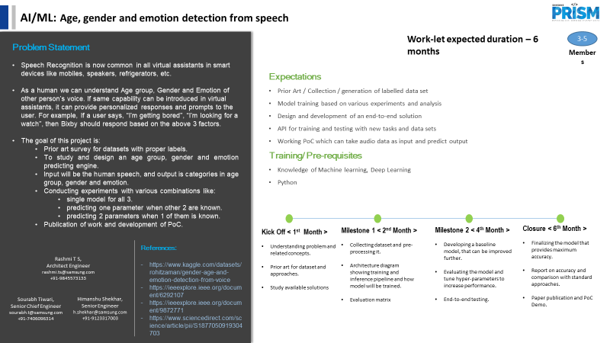

Information Retrieval | SQL to Lucene Query Parser
Notes:
-

Slide 3
KPIs Achieved Till Now
Compared the performance of the combined model with the individual models for age, gender, and emotion detection.
Measured the time taken to train each model.
Measured the inference time: Time taken by model to make predictions.
Explored the dependencies between the target variables.

Slide 4
Challenges Faced
Emotions are subjective, and individuals may express them differently, making it challenging to create a one-size-fits-all model.
Instances where age, gender, and emotion cues provide conflicting information poses difficulty in making accurate predictions.
Insufficient or biased training data.
Identifying relevant features for age prediction that are both informative and resistant to noise can be difficult.
Achieving real-time processing for voice-based models posed challenges due to computational constraints.
Cultural and social norms related to gender expression introduces bias, affecting the model's generalization.

Slide 5
Next Steps
Identify any potential biases or imbalances in the data.
Investigate how age, gender, and emotion labels are correlated in our dataset.
Review and potentially refine the features used in the models based on the label dependency analysis.
Evaluate the accuracy of the models by treating age, gender, and emotion as labels in different scenarios. For example, calculate the accuracy of age prediction when gender and emotion are treated as labels, and vice versa.
Perform cross-validation to ensure robustness of the models and to assess how well they generalize to new data.
Based on the evaluation results, iteratively refine your models. This may involve adjusting features, incorporating new data, or fine-tuning model parameters.
Include metrics that assess the accuracy of one prediction when the other two are treated as labels.

Slide 6
Key Achievements/Outcome Till Now
Developed a unified model for age, gender, and emotion detection.
Gone through several models similar to our project to analyze our model for better accuracy.
Explored ensemble methods, such as combining predictions from multiple models or modalities to improve overall accuracy.
Explored various feature engineering techniques employed in similar projects to enhance the representation of age, gender, and emotion-related cues.
Explored data augmentation techniques and preprocessing methods applied in similar projects to increase the diversity and quality of the training dataset.

Slide 7
Thank you

